Slide 1


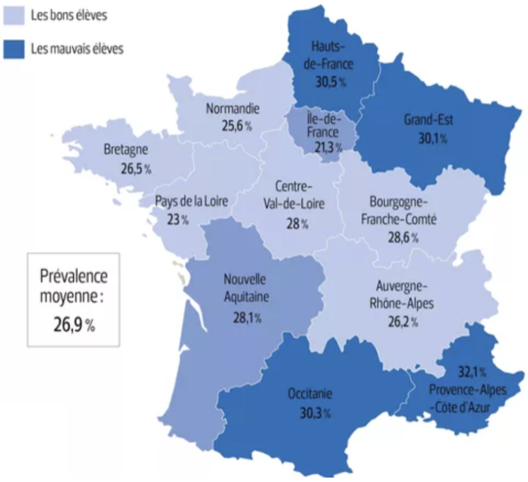
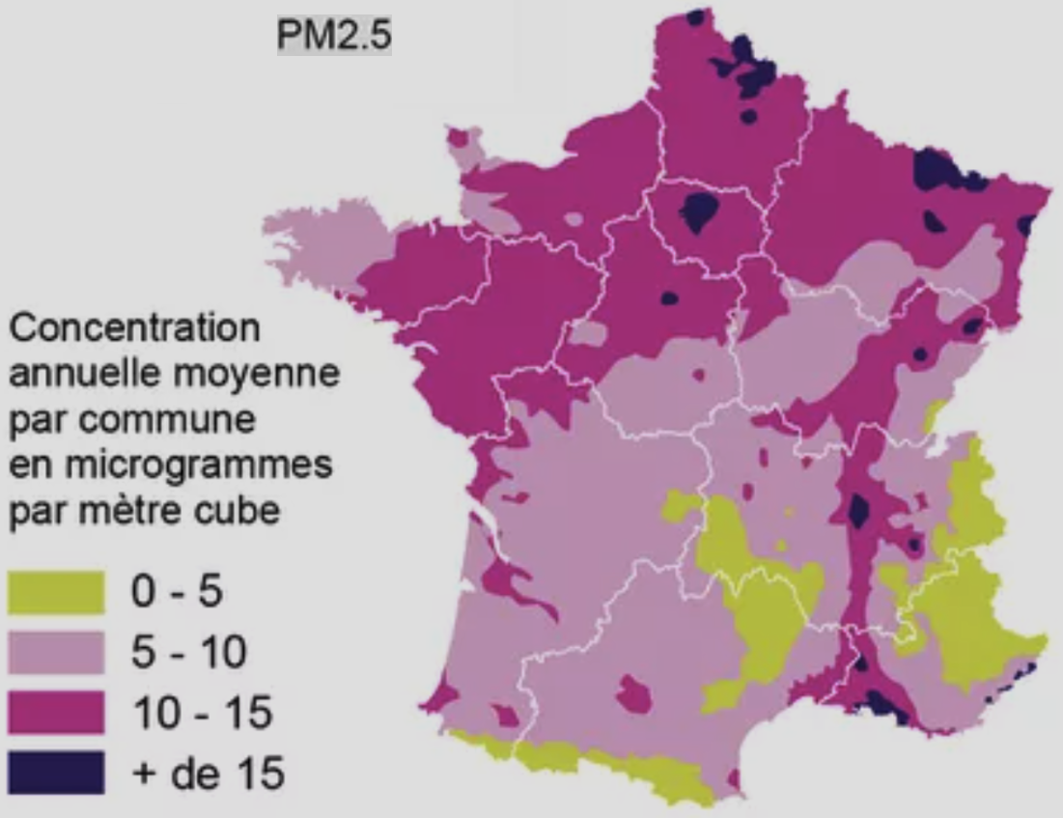
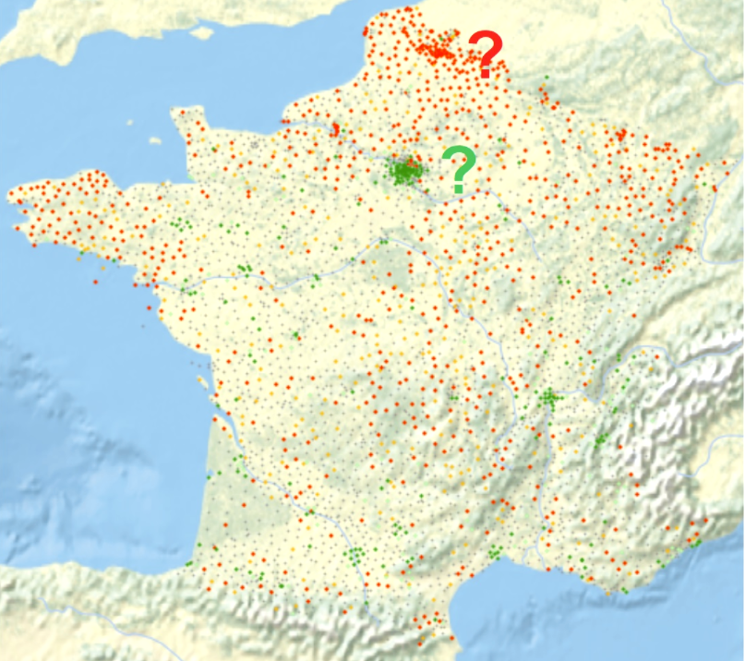

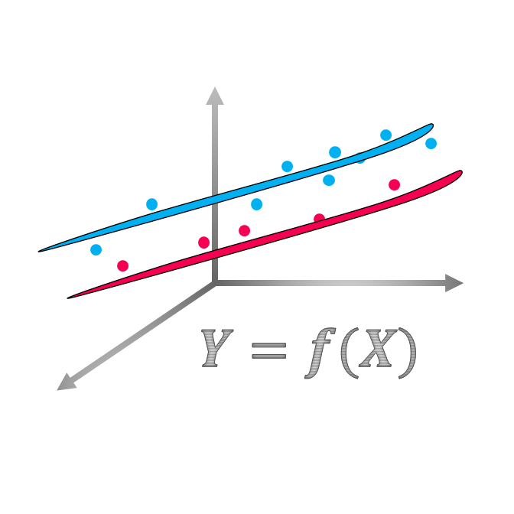

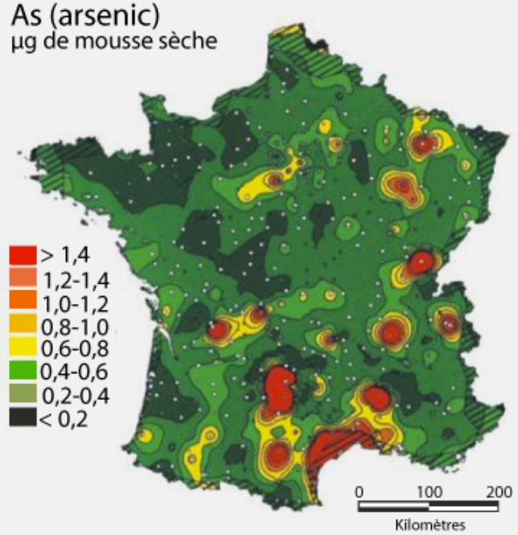

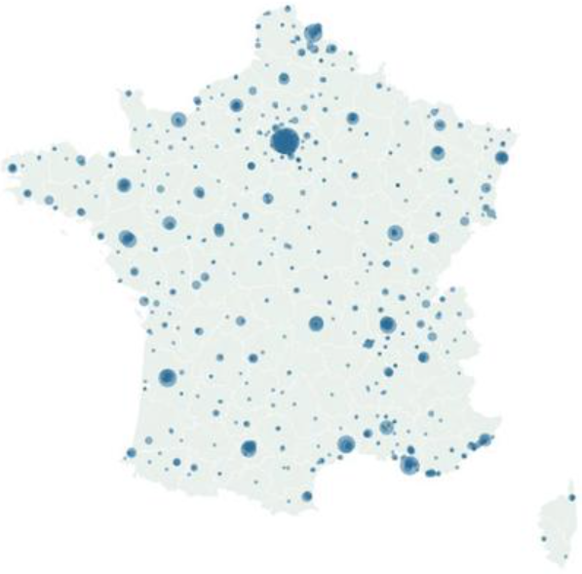
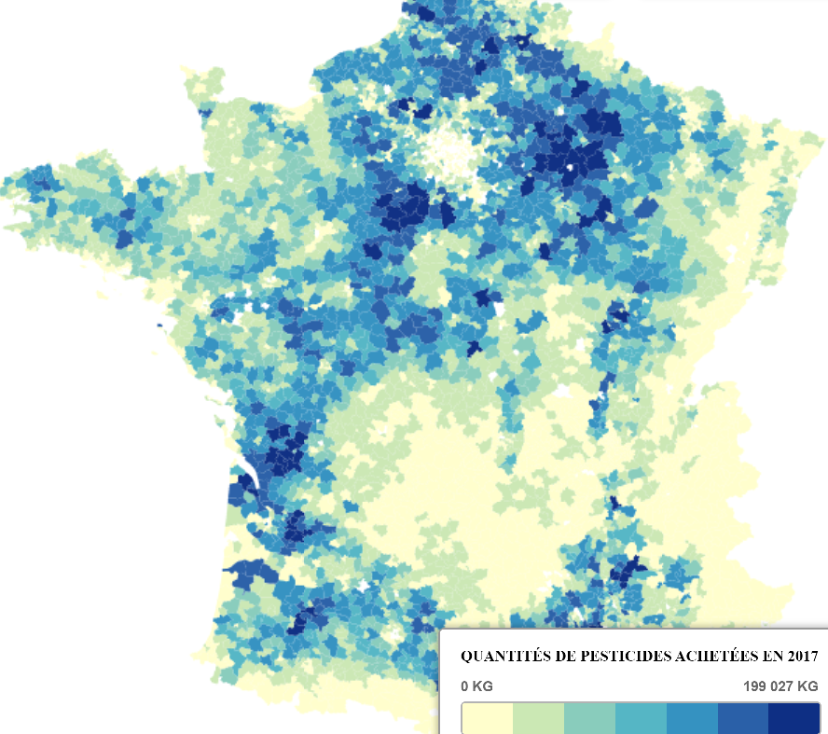

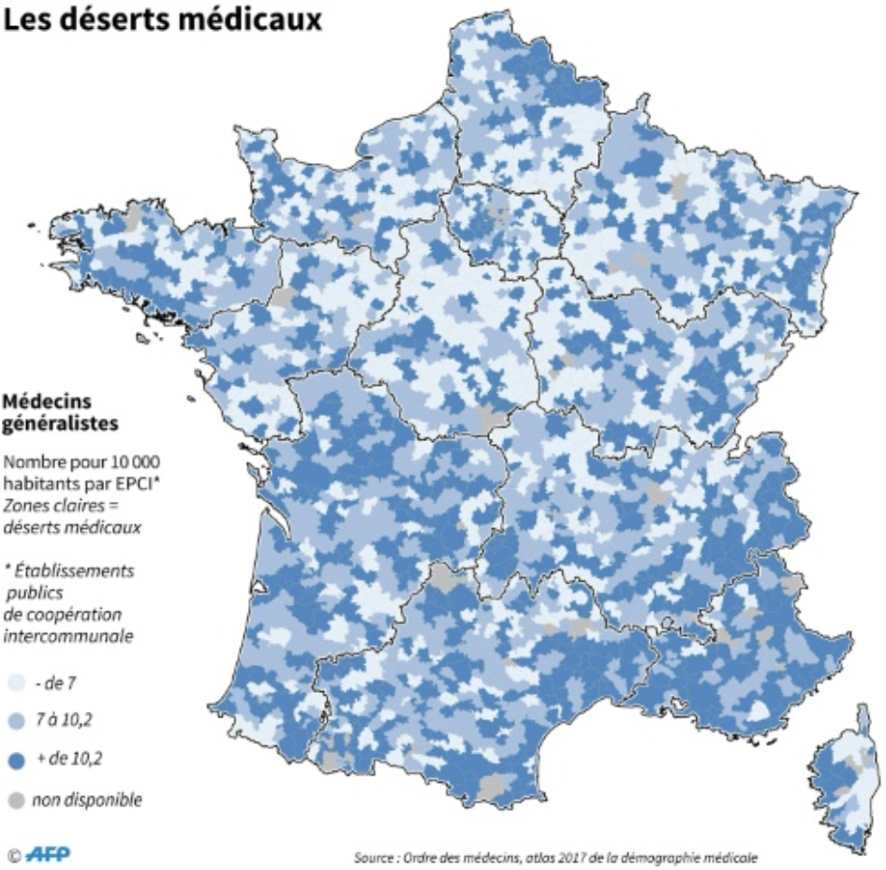

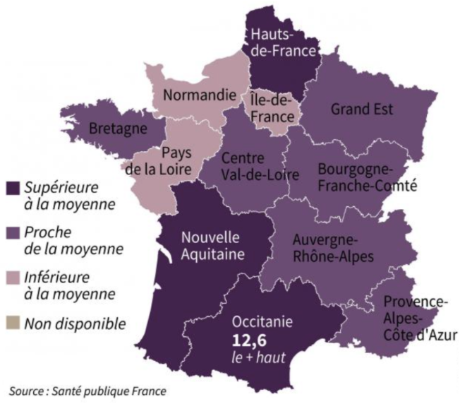
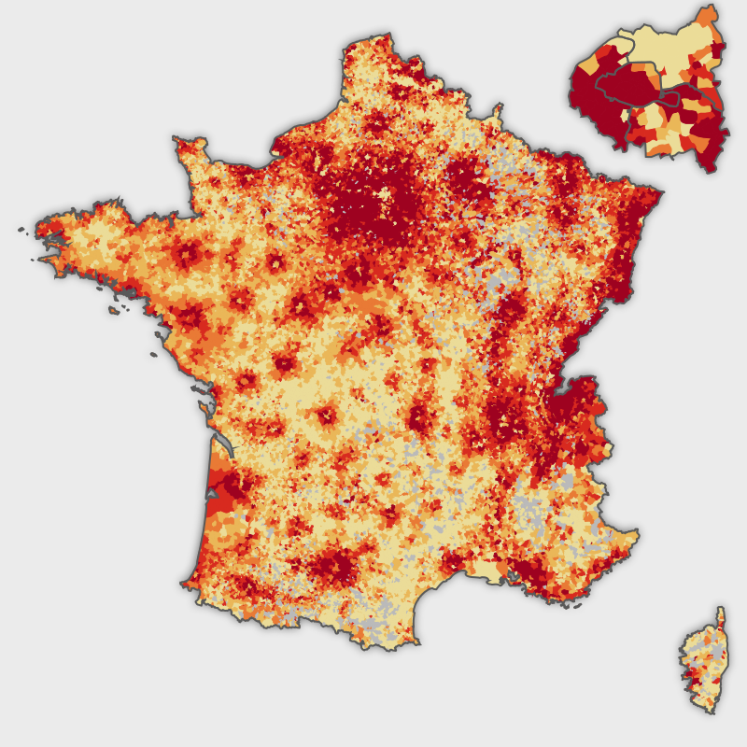
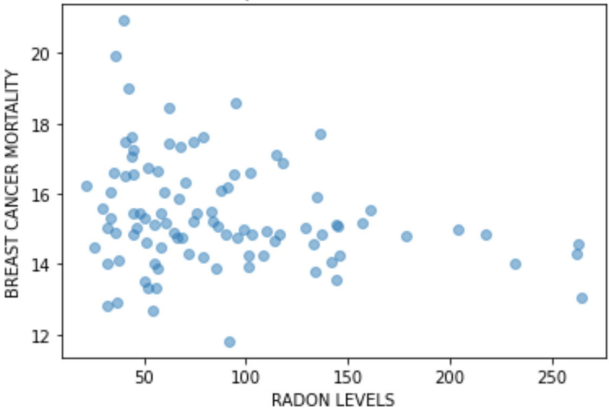
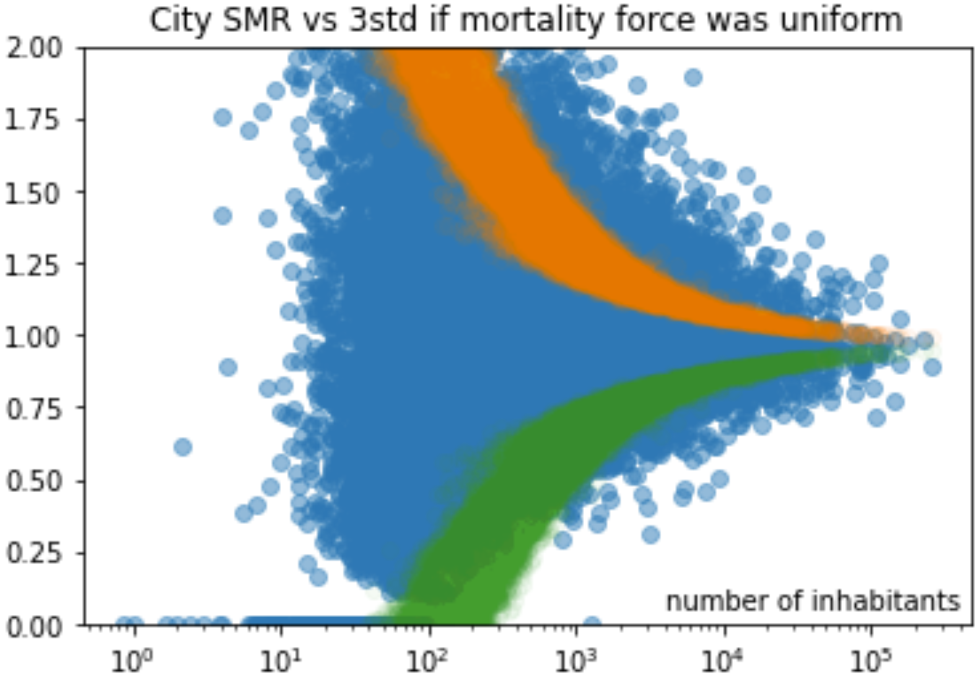
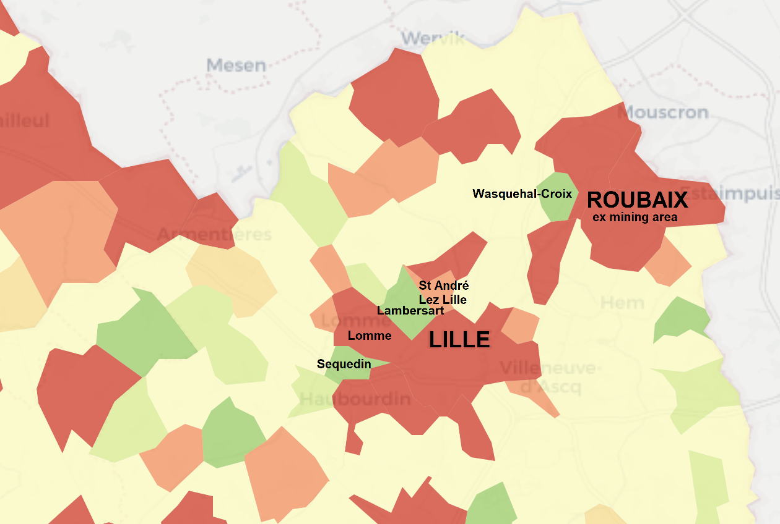
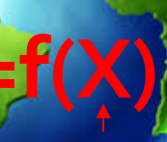
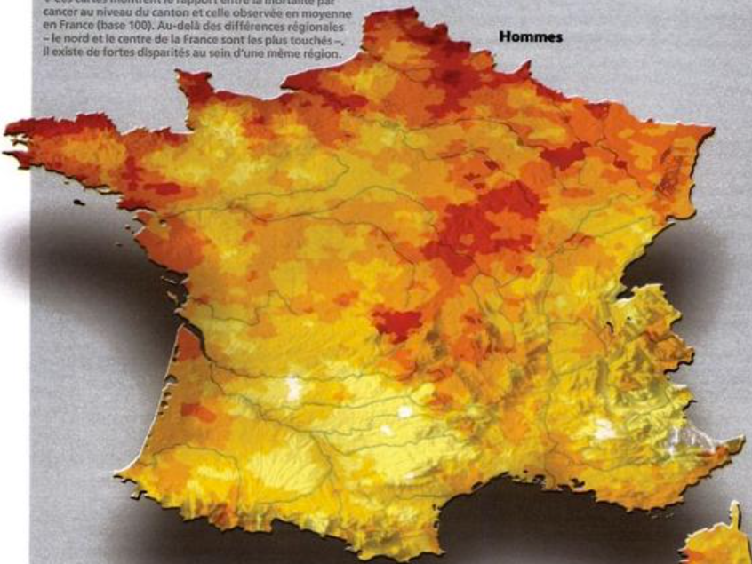

OpenData4Health.org
Lessons from humanity for humanity!
Following a proof of concept in 2015-2016… a longer term project
Cancer Baseline
• Deepen the analysis for one country
PM 2.5
smoking
HEAlthy Life Extension Society
Cancer risk
Y=f(X)
• Build a community
to deepen & enlarge analysis to other countries over time
over
vs ?
under
mortality
arsenic
risk/protection factors
pesticides
a) General insight
b) Specific cases
• Highlight issues & solutions and suggest changes
& disease contributions
cancer
Epidemium Season 1, 120 volunteers gathering data from different countries and modelling Y=f(X)
medical
medical
practice
Reasons to believe
alcohol
deserts
Antoine Flahault: Notre santé a besoin d'un atlas et de données publiques
Citizens & authorities together: Des dioxines à Lausanne !
wealth
Lessons learned so far
Not granular ➔ spurious correlations
Granular ➔ statistics needed
Wealth // behaviors: the case of Lille
NEOS – how to use geographic factors
Mortality of cancers at canton level
& of diseases at department level
https://github.com/Epidemium/EPIDEMIUM-Season-3/OpenData4Health (BSD 2) Edouard Debonneuil, Pol Sans, Ayesha Kawser, Sylvain Sorrin, Pascal Deschaseaux, Sébastien de Longeaux, Adrien Helary, Rachel Aronoff Sources in opendata4health.org

